Slide 1
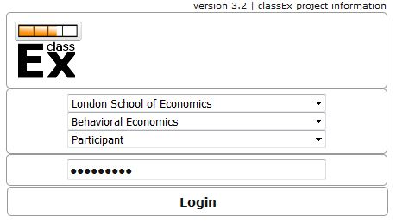
University
Course
User mode
Password

Slide 2
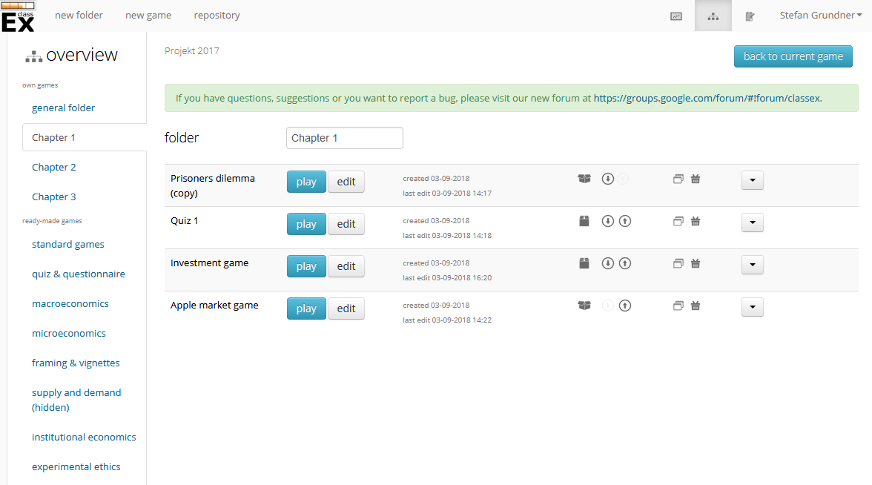
Lecture mode
Overview
Editing mode
Drop down
Move up and down
Private game
Copy game
Public game
Delete game
Move game to different folder

Slide 3
Login QR code
Add test player
Diagnostic mode

Slide 6
